Slide 1

Sturctured Query Language
Structured query language (SQL) is a programming language for storing and processing information in a relational database.
A relational database stores information in tabular form, with rows and columns representing different data attributes and the various relationships between the data values.
You can use SQL statements to store, update, remove, search, and retrieve information from the database. You can also use SQL to maintain and optimize database performance.
Free SQL Downloads :
Oracle SQL Developer
Microsoft SQL Server Express
SQL Server 2022 Developer

Slide 2


SQL Uses
Data Science & Analytics
Machine Learning & AI
Cloud and Big Data
Blockchain and Decentralized Systems
Primary keys
Primary Key: Ensures each record is unique and identifiable.
Non-null: Cannot contain NULL values.
Single or Composite: Can be one column or a combination of columns.Primary keys can be classified into two categories Simple primary key that consists of one column and composite primary key that consists of Multiple column.

Slide 3
Benefits:
Data Integrity: The primary key enforces data integrity by ensuring each record is unique.
Efficient Querying: Since a primary key automatically creates an index, querying for records by the primary key is faster.
Referential Integrity: Primary keys are used to establish relationships between tables (via foreign keys), ensuring consistency across related data.
Common Issues
Avoid NULL values: Always ensure that the columns involved in the primary key do not accept NULL values.
Choose meaningful primary keys: If possible, choose a primary key that naturally fits the data and serves as a meaningful identifier, like an ID field.
Composite Keys: Be cautious when using composite keys. While they are useful in some scenarios, they can make queries more complex. If possible, use a simple key or generate an artificial primary key (like an ID).
Changing Primary Keys: Once a primary key is established, changing it can be difficult because of the interdependencies with other tables (foreign key constraints). Always plan ahead when designing your database schema.

Slide 4
FOREIGN KEY
key is beneficial when we connect two or more tables so that data from both can be put to use parallelly.
It is a column or set of columns in one table that references the primary key columns of another table. This creates a relationship between the two tables, ensuring that the child table (which contains the foreign key) can only have values that exist in the parent table’s primary key column(s).
The table containing the foreign key is called the foreign table (or child table), and the table that the foreign key references is called the primary table (or parent table).
Example:
Table STUDENT STUD_NO in STUDENT_COURSE is a foreign key to STUD_NO in STUDENT relation.
STUD_NO | Student _NAME | STUD_COURSE

Slide 5
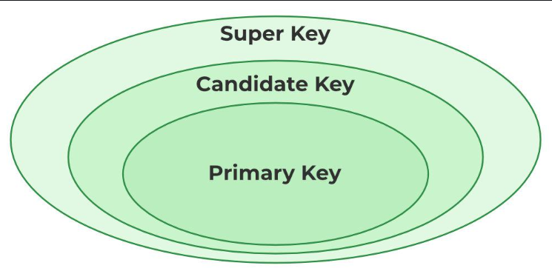
Super Key
The set of one or more attributes that can uniquely identify a tuple is known as Super Key. For Example, STUD_NO, (STUD_NO, STUD_NAME), etc.
A super key is a group of single or multiple keys that uniquely identifies rows in a table. It supports NULL values in rows.
A super key can contain extra attributes that aren’t necessary for uniqueness. For example, if the “STUD_NO” column can uniquely identify a student, adding “SNAME” to it will still form a valid super key, though it’s unnecessary.

Slide 6

Candidate Key
The minimal set of attributes that can uniquely identify a tuple is known as a candidate key.
A candidate key is a minimal super key, meaning it can uniquely identify a record but contains no extra attributes.
It is a super key with no repeated data is called a candidate key.
The minimal set of attributes that can uniquely identify a record.
A candidate key must contain unique values, ensuring that no two rows have the same value in the candidate key’s columns.
Every table must have at least a single candidate key.
A table can have multiple candidate keys but only one primary key.
For Example, STUD_NO in STUDENT relation.
STUD_NO is the candidate key for relation STUDENT
ADD A MAIN POINT
Briefly elaborate on what you want to discuss.
ADD A MAIN POINT
Briefly elaborate on what you want to discuss.

Slide 7

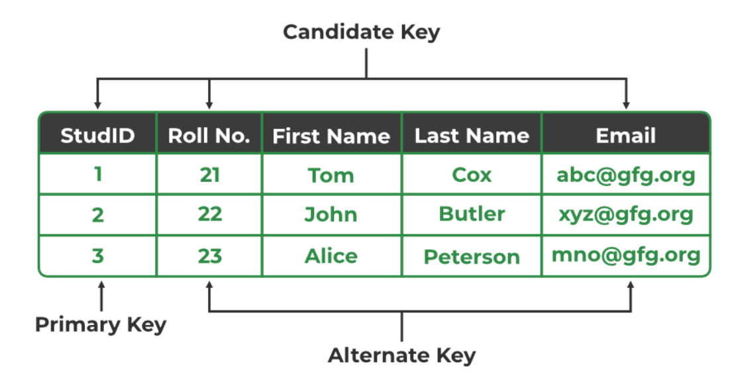
Alternate Key
An alternate key is any candidate key in a table that is not chosen as the primary key. In other words, all the keys that are not selected as the primary key are considered alternate keys.
An alternate key is also referred to as a secondary key because it can uniquely identify records in a table, just like the primary key.
An alternate key can consist of one or more columns (fields) that can uniquely identify a record, but it is not the primary key
Eg : STUD_ID, as well as Email both, are candidate keys for relation STUDENT but Email will be an alternate key (only one out of many candidate keys).
Elaborate on what you want to discuss.
02
Elaborate on what you want to discuss.

Slide 8
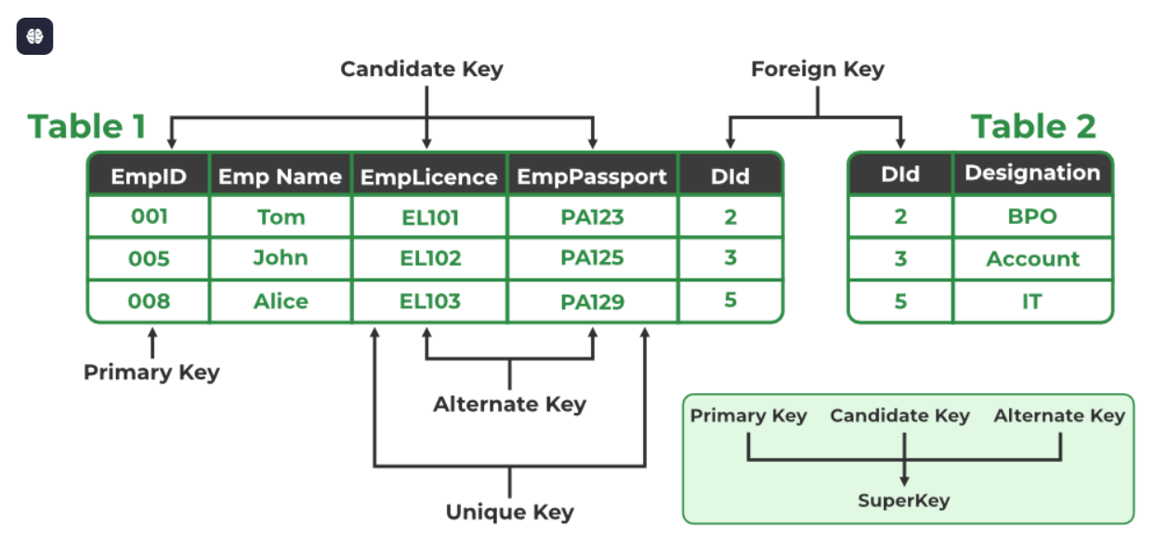
Composite Key
Sometimes, a table might not have a single column/attribute that uniquely identifies all the records of a table. To uniquely identify rows of a table, a combination of two or more columns/attributes can be used. It still can give duplicate values in rare cases. So, we need to find the optimal set of attributes that can uniquely identify rows in a table.
It acts as a primary key if there is no primary key in a table
Two or more attributes are used together to make a composite key .
Different combinations of attributes may give different accuracy in terms of identifying the rows uniquely.
Eg: FULLNAME + DOB can be combined together to access the details of a student

Slide 9

Thank you

